Slide 1
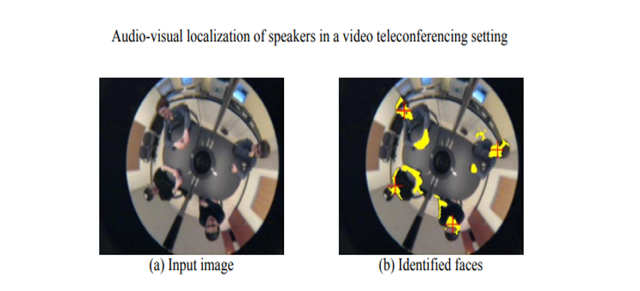
INDEPENDENT STUDY
Diksha Agarwal

Slide 2
CONTEXT
The project involves localization of sound sources using four microphone arrays (we have considered a square geometry).
The primary motivation behind this project was the localization of sound sources in a conference meeting room. So, basically, we intend to zoom or focus our camera on the person who is speaking. Also, we aimed at removing background noises when the speaker is speaking in the zoom calls etc.

Slide 3
ALGORITHM
1. Consider a microphone array. (Considered a 4 micro phone array, square is the use case)
2. Consider speaker source at SX, SY (typically inside square). This is ground truth value.
3. Compute transit time to each microphone (4 values). Using Euclidean distance formulae.
4. Generate a sound signal sampled at 20 ksamples/sec i.e. (0.25 s) for example approx. 20 pts)
5. Create associated time vector to correspond to sampling times
6. Add delay to the four sound signals using circshift in MATLAB. Basically, the delay will be added as number of points shifted. To calculate the number of points to shift we do (transit time calculated in Step 3)/ time interval. Here time interval is 1/sampling freq.
7. Now we will use xcorr function in MATLAB.
8. After doing co-relation we will have the number of points each signal is shifted with respect to each other. So, we can calculate delay using (number of points) * time interval.
9. Now, basically we know time difference of arrival. So, it will be a hyperbola trajectory. So, we can calculate the estimated source location.
10. After finding estimated source location we can calculate the error with ground truth value

Slide 4
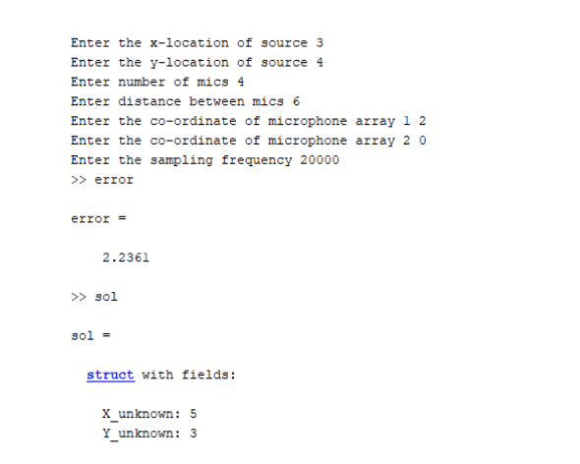
COMMAND LINE

Slide 5
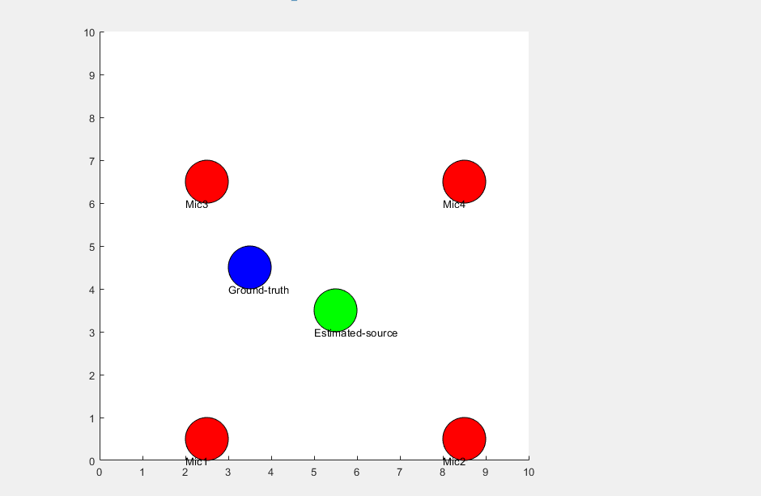
RESULTS

Slide 6
IMPORTANT LINKS
GitHub Link: https://github.com/DIKSHAAGARWAL2015/Teleconferencing-application/
Video:

Slide 7
FUTURE WORK
We plan to produce a startup idea with this project. For now, it is just a basic implementation in MATLAB. We plan to develop it fully on Quadric process next semester.

